Slide 1
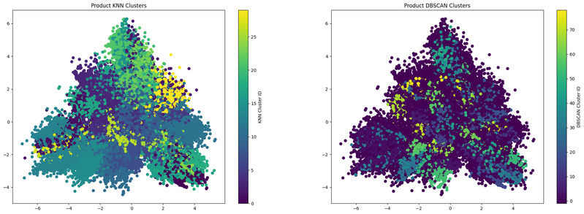
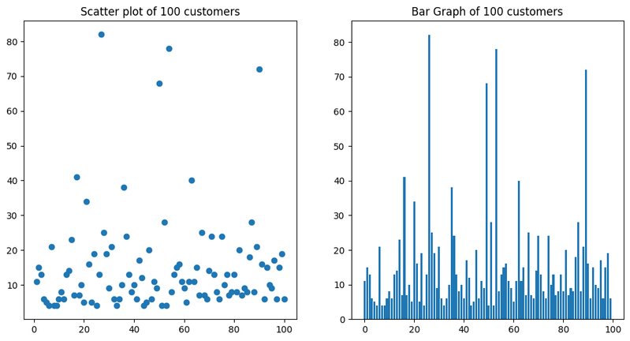
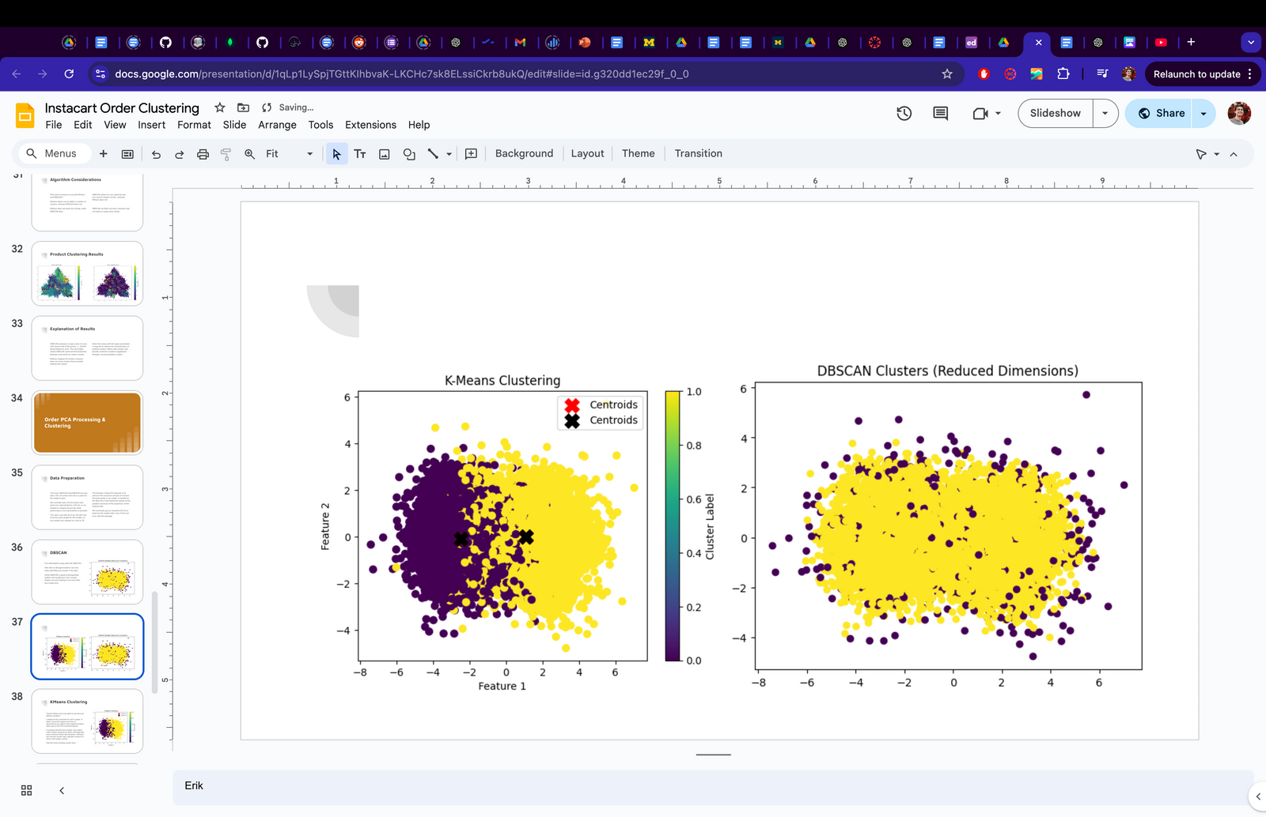
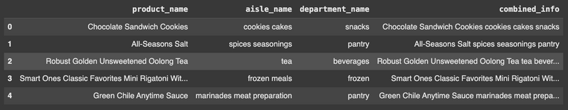

Instacart Order Clustering
Overview Description
This project leverages unsupervised learning to identify product and customer transaction clusters within the Instacart dataset. The dataset includes over 3 million orders and 49,688 products, spanning 134 aisles and 21 departments.
Erik Nielsen & Orvil Escalante
Research Questions
1) What associations between products can be identified through clustering?
2) What insights can clustering customer transactions provide about purchasing patterns and habits?
Key Goal
To empower stakeholders with actionable insights on consumer behavior and customer segmentation.
Data
Number of transactions for first 100 customers
Order Clustering
KMeans Results: Two clusters identified; smaller orders focused on common items like bananas, larger orders had a wider variety.
DBSCAN Results: Significant noise cluster formed, suggesting room for parameter tuning.
Algorithms & Methodology Algorithms Used
Word2Vec: Generates product embeddings for clustering. KMeans: Defines product clusters with n=30.
DBSCAN: Handles non-convex clusters & filters noise.
Preprocessing Steps
Merging datasets (orders, products, aisles, departments). Tokenization of product information for embedding. Dimensionality reduction using PCA to ensure compatibility with clustering algorithms.
Impact & Bias
Positive: Enhanced personalization for customers, insights for better inventory management.
Negative: Risk of demographic and selection biases impacting representativeness.
Bias Mitigation: Random sampling (5% of customers) to reduce misrepresentation risks. Further exploration needed to address product and geographic biases.
Inputs & Outputs
Input: Product embeddings, customer transactions.
Output: Clusters of products and customer orders
Next Steps
Experiment with alternative clustering methods (e.g., Hierarchical Clustering).
Address challenges in embedding representation for higher fidelity.
Expand dataset sampling to improve robustness
Product Clustering
DBSCAN: Produced a large cluster of noise with almost half of the points, n = 26,544 being labeled as such. This most likely means DBSCAN could not find similarities between such points to create a cluster.
KMeans: Mapped 30 clusters, however there are some clusters that are better defined than others.
Sources
Kaggle: Instacart Market Basket Analysis.
Google Developers: ML Crash Course on Embeddings.
TensorFlow: Word2Vec Tutorial.
Nielsen & Escalante (2024): AI4ALL. Collab

